Slide 1
Ethics 101
Franklin Elementary School
November 20, 2015

Slide 2
Our Mission
Our Mission To promote the process and practice
of ethical decision-making
in primary and secondary school communities.

Slide 3
Our Vision: To Empower the World to Live Ethically
Educator Professional Development
Parent Programs
In the form of workshops and discussion groups,
Ethics Institute scholars have provided multiple learning opportunities to the Kent Place School
parent community.
Ethics Institute scholars provide workshops to countless educators in the United States and Canada, offer workshops annually to Kent Place personnel and present at multiple conferences.
Parent
Programs
Educator Professional Development
Student Learning
Student Learning
Bioethics Project
We provide faculty leadership and
program support for the Junior Ethics
Seminar and ethical decision-making workshops. We support a team that participates in the National High
School Ethics Bowl.
Bioethics Project
A student-driven research program, The Bioethics Project involves pairs of student researchers and professional scholars. The student researchers generate a public website, as well as a community symposium.
Ethics in
Action
Ethics in Action
This innovative program, in partnership with Georgetown University’s Kennedy Institute of Ethics, combines ethical decision-making with design thinking. EIA brings teams of educators and students from various schools to the Kent Place campus to develop ethical decision-making and leadership skills which they will apply to ethical challenges within their own school communities.

Slide 4
Conversation Norms
One speaker at a time
Share the air – say what’s core
Use “I” statements
You are the owner of your own experience
Practice purity of motive
“Ouch!”, then educate
Take responsibility for what you say and how you say it
Maintain confidentiality
Be real, take off the mask!
Lean into discomfort; take positive risks

Slide 5
Cheating Statistics Educational Testing Service and Ad Council Campaign
Statistics show that cheating among high school students has risen dramatically during the past 50 years.
In the past it was the struggling student who was more likely to cheat just to get by. Today it is also the above-average college bound students who are cheating.
73% of all test takers, including prospective graduate students and teachers agree that most students do cheat at some point. 86% of high school students agreed.
Cheating no longer carries the stigma that it used to. Less social disapproval coupled with increased competition for admission into universities and graduate schools has made students more willing to do whatever it takes to get the A.
While about 20% of college students admitted to cheating in high school during the 1940's, today between 75 and 98 percent of college students surveyed each year report having cheated in high school.

Slide 6
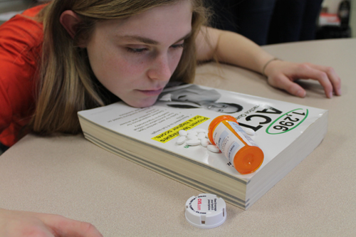

Slide 7
“A Calm Brain”
“Modern demands on our brains – from the insistent buzz of technology to the persistent illusion of urgency – dictate this ill-advised shift toward the alarm zone of our body and brain apparatus, at great cost to our well-being and peace of mind.”
A Calm Brain: How to Relax Into a Stress-Free, High-Powered Life, by Gayatri Devi, MD, 2012.

Slide 8
Ethics?

Slide 9
Do you discuss ethical issues with your children?
How do you discuss ethical issues with your children?

Slide 10
Three Types of Parenting
“Helicopter”
“Lawnmower”
“Ethical”

Slide 11
Case Study: Balleyville High School
The mood at Balleyville High School is tense with anticipation. For the first time in many, many years, the varsity basketball team has made it to the state semifinals. The community is excited, too, and everyone is making plans to attend the big event next Saturday night.
Mr. Smith, the varsity coach, has been waiting for years to field such a team. Speed, teamwork, balance: They’ve got it all. Only one more week to practice, he tells his team, and not a rule can be broken. Everyone must be at practice each night at the regularly scheduled time – No exceptions!

Slide 12
Case Study: Balleyville High School
Brad and Mike are two of the team’s starters. From their perspective, they’re indispensable to the team, the guys who will bring Balleyville to victory. They decide – why, we’ll never know – to show up an hour late to the next day’s practice.
Mr. Smith is furious. They have deliberately disobeyed his orders. The rule says that they should be suspended for one full week. If he follows the rule, Brad and Mike will not play in the semifinals. But the whole team is depending on them. What should Mr. Smith do?

Slide 13
Ethical Dilemma or Moral Dilemma?

Slide 14
Ethics
“A system of moral principles; the branch of philosophy dealing with human values and moral conduct. The science of moral duty or the science of ideal human character.”
In Search of Ethics: Conversations with Men and Women of Character (Marella), 2001

Slide 15
“Doing” Ethics
A “Process”
and
a “Practice”

Slide 16
What are Values?
“something (principle, quality, or entity) intrinsically desirable or valuable”
Webster’s 3rd New International Edition
“A value is a personal or societal belief based on…what is considered important. They are tangible or intangible, and something to live by.”
Dr. Rezach’s Ethics Class, Spring 2007

Slide 17
Truth/Honesty
Responsibility
Respect Source: Institute for Global Ethics, 2009

Slide 18
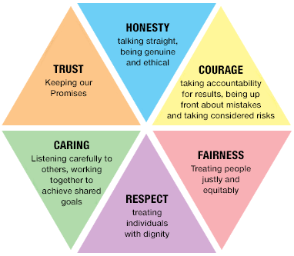
Values
Honesty
Trustworthiness
Integrity
Promise-keeping
Accountability
Loyalty
Justice
Autonomy
Privacy
Safety
Security
Equality
Fairness
Respect
Responsibility
Service
Compassion
Friendship
Independence
Authenticity

Slide 19
What Are Your Top 3 Personal Values?

Slide 20
Courage

Slide 21
Humility is not thinking less of yourself, it’s thinking of yourself less.

Slide 22
Humility

Slide 23
Ethical Dilemma
A choice between two or more values
“Right” versus “Right” situation

Slide 24
The Ethics Institute at Kent Place School
A Values-Based Approach to Ethical Decision-Making

Slide 25
1. Study and understand the situation.

Slide 26
2. Identify the values that are involved on all sides.

Slide 27
3. Identify the ethical dilemma – right vs right.

Slide 28
4. Identify the values that influence your position.

Slide 29
5. Communicate effectively and respectfully a decision that demonstrates the ability to apply the facts identify values that inform your position refer to other sources to build the argument

Slide 30
The Ethics Institute Ethical Decision-Making Method
Study and understand the situation.
Identify the values that are involved on all sides.
Identify the ethical dilemma – right vs. right.
Identify the values that influence your position.
Communicate effectively and respectfully a decision that demonstrates the ability to
apply the facts
identify values that inform your position
refer to other sources to build the argument

Slide 31
Case Study: Abby
You and your spouse are parents in a quiet suburban neighborhood. You are very clear about the rules in your home, and the values that your family holds. “Internet Use” is one much-discussed topic in your family; your 5th daughter, Abby, is well-aware that there are set guidelines when it comes to age-appropriate movies and internet games. Abby knows to ask for parental guidance if unsure about the age-appropriateness of content, particularly violence, profanity, etc.
Abby’s best friend is Julia, a smart, kind and athletic student in Abby’s class. The girls get along very well and have been close friends throughout elementary school. Though friendly with Julia’s parents, they are not part of your close social network.

Slide 32
Case Study: Abby
Abby goes to Julia’s house for a playdate. When she comes home, she is very excited about an internet game that she and Julia played, and she wants permission to continue to play. You are shocked to learn that the game is Grand Theft Auto, one of the most violent and profane games available. You are horrified. As you discuss this situation further with Abby, it becomes clear to you that Julia’s parents were aware that the girls were playing the game, were present in the room, and had no issue with it.
You stand looking at your daughter. What do you do?

Slide 33
The Ethics Institute Ethical Decision-Making Method
Study and understand the situation.
Identify the values that are involved on all sides.
Identify the ethical dilemma – right vs. right.
Identify the values that influence your position.
Communicate effectively and respectfully a decision that demonstrates the ability to
apply the facts
identify values that inform your position
refer to other sources to build the argument

Slide 34
Contact Information
Dr. Karen Rezach – rezachk@kentplace.org
Dr. Eva Lazar – lazare@kentplace.org

Slide 35
Thank You!
Follow us on Twitter @EthicsInstitute.
Like us on Facebook.
www.kentplace.org/ethics

